Slide 1
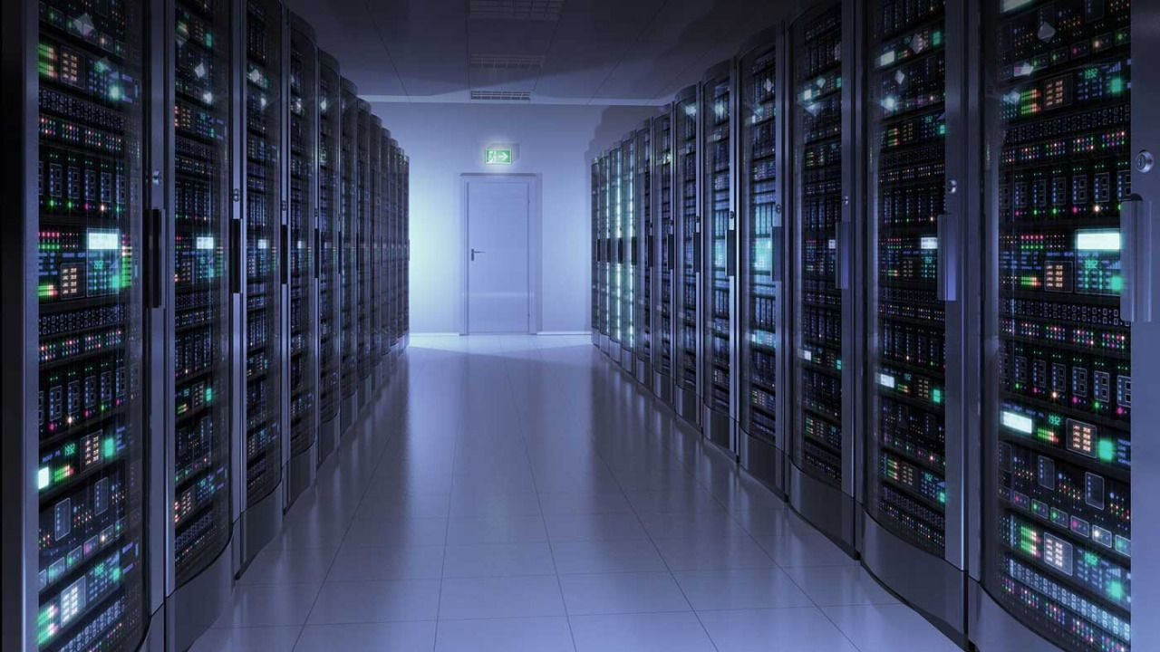

GPU Programming (in CUDA)
Fall 2018
Julian Gutierrez
Session 9

Slide 2
Outline
Image Processing
Final Project

Slide 3
Why Do We Process Images?
Enhancement and restoration
Remove artifacts and scratches from an old photo/movie
Improve contrast and correct blurred images
Transmission and storage
Images and Video can be more effectively transmitted and stored
Information analysis and automated recognition
Recognizing terrorists
Evidence
Careful image manipulation can reveal information not present
Detect image tampering
Security and rights protection
Encryption and watermarking preventing illegal content manipulation

Slide 4
Examples

Slide 5
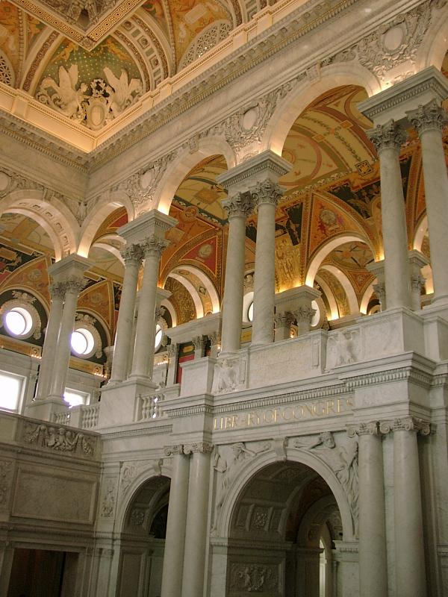
Compression
Color image of 600x800 pixels
Without compression
600*800 * 24 bits/pixel = 11 520K bits = 1.44M bytes
After JPEG compression (popularly used on web)
only 89K bytes
compression ratio ~ 16:1
Movie
720x480 per frame, 30 frames/sec, 24 bits/pixel
Raw video ~ 243M bits/sec
DVD ~ about 5M bits/sec
Compression ratio ~ 48:1
“Library of Congress” by M.Wu (600x800)

Slide 6
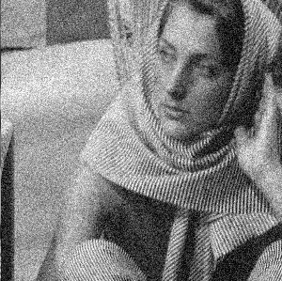
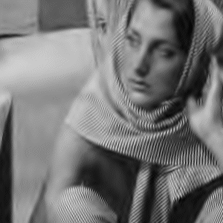
Denoising
From X.Li http://www.ee.princeton.edu/~lixin/denoising.htm

Slide 7
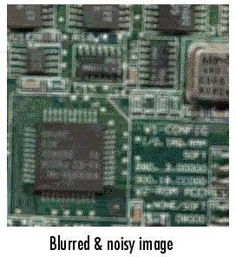
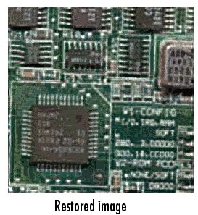
Deblurring
From Mathworks

Slide 8
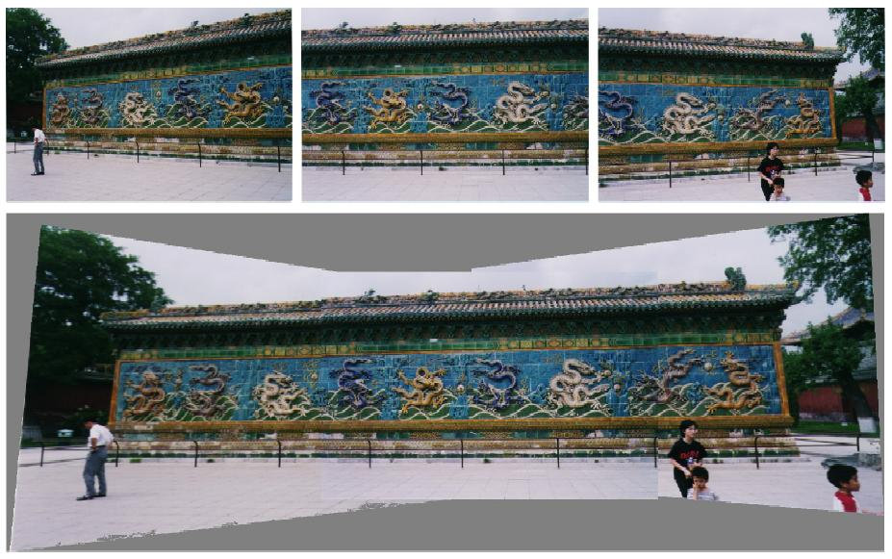
Visual Mosaicing
Stitch photos together without thread or scotch tape
R.Radke – IEEE PRMI journal paper draft 5/01

Slide 9
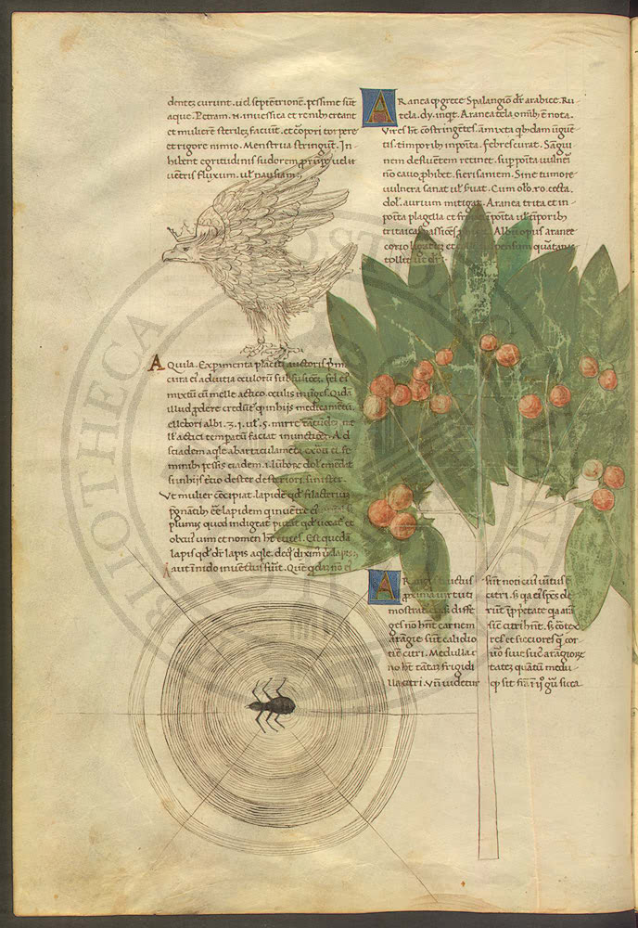
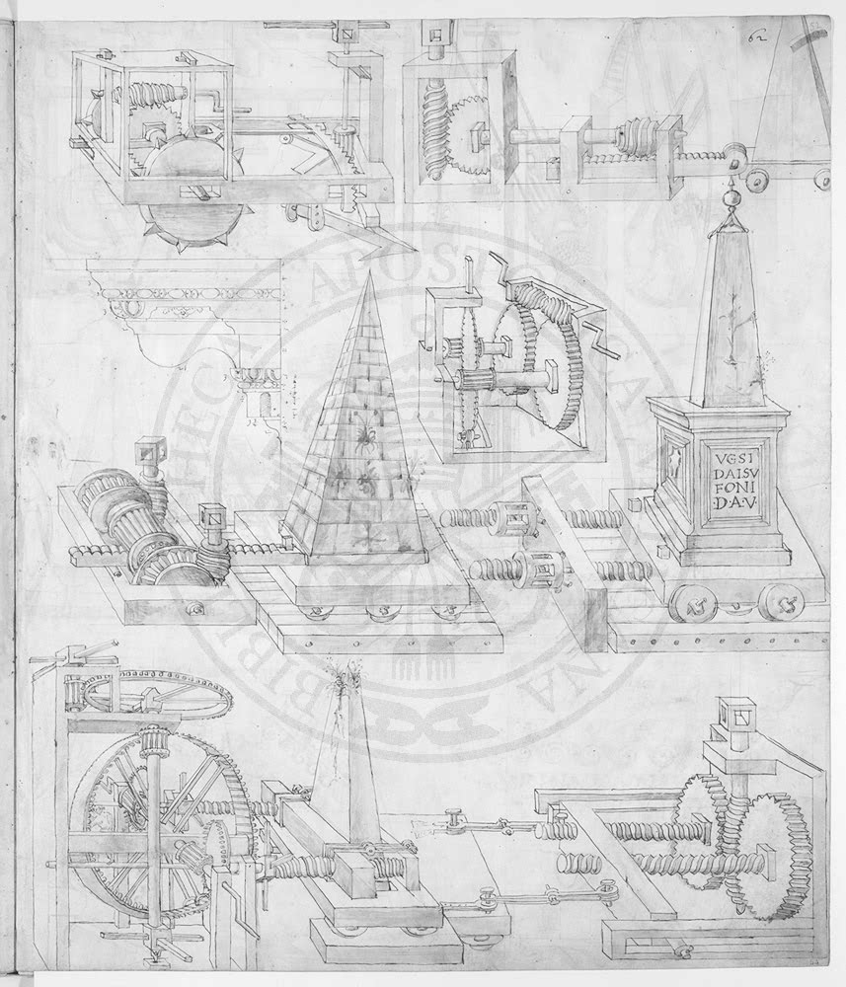
Visible Digital Watermarks
from IBM Watson web page “Vatican Digital Library”

Slide 10
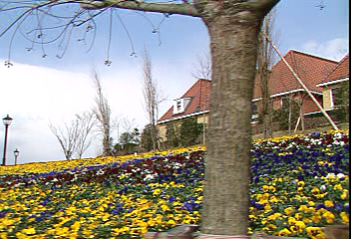

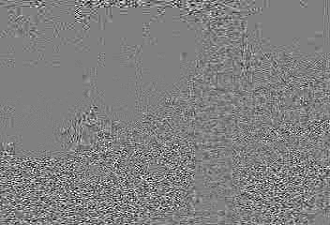
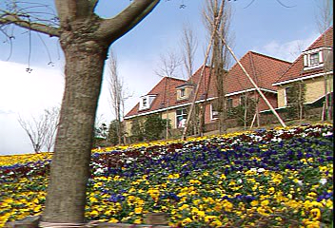

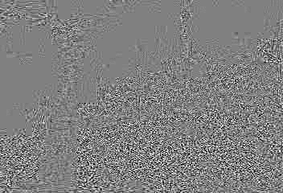
Invisible Watermark
1st & 30th Mpeg4.5Mbps frame of original, marked, and their luminance difference
human visual model for imperceptibility: protect smooth areas and sharp edges

Slide 11
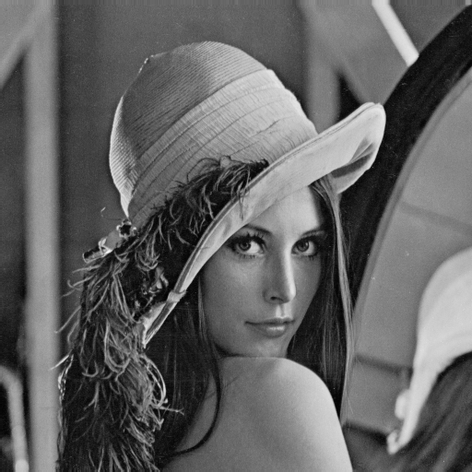
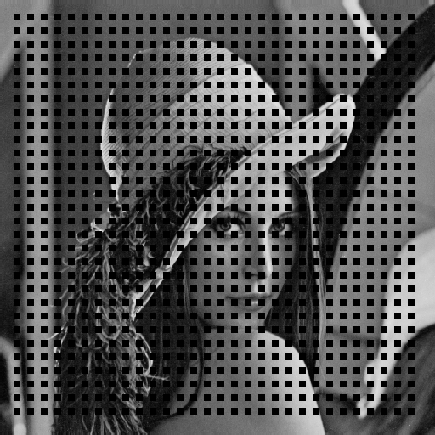

Error Concealment
(a) original Lenna image
(b) corrupted Lenna image
(c) concealed Lenna image
25% blocks in a checkerboard pattern are corrupted
corrupted blocks are concealed via edge-directed interpolation
Examples were generated using the source codes provided by W.Zeng.

Slide 12
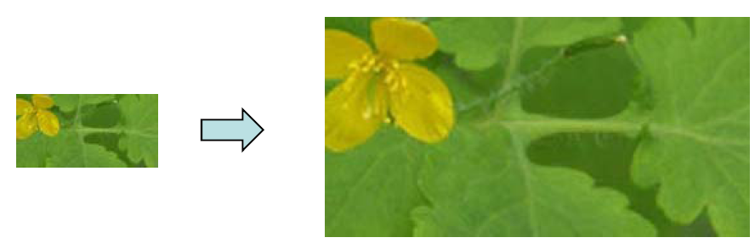
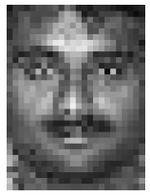
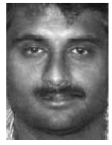

Image Super-Resolution
• Super-Resolution(SR)
Low resolution images High resolution images
• Face Hallucination
Super-resolution on human faces
• Constraints
– Reconstruction constraints
Close to input image when blurred and down-sampled
– Global structure constraints
Recovered image should be like a face
– Sparsity assumption
Sparse coefficients are preserved during down-sampling
Courtesy of Jianchao Yang

Slide 13
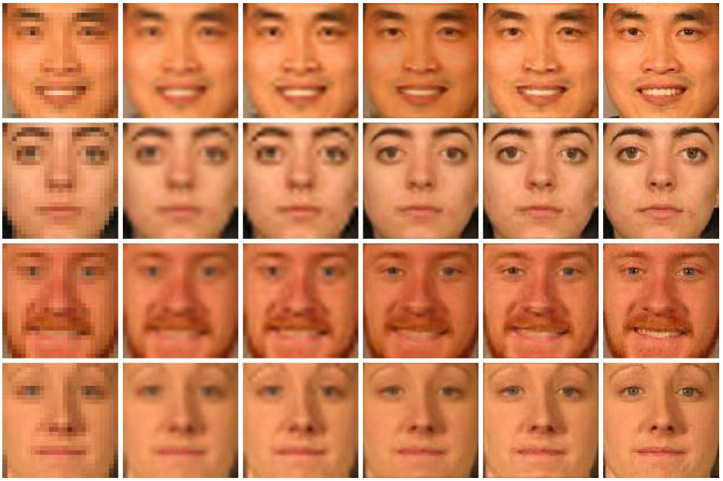
Face Hallucination
Input image
Bicubic interpolation
Back projection
NMF
Sparse Coding
Original
Courtesy of Jianchao Yang

Slide 14
What is an Image?

Slide 15
What is an image?
We can think of an image as a function, f:
f( x, y ) gives the intensity at position ( x, y )
Realistically, we expect the image only to be defined over a rectangle, with a finite range:
f: [a,b]x[c,d] → [0,1]
A color image is just three functions pasted together. We can write this as a “vector-valued” function
Notes:
As opposed to [0..255]

Slide 16
Images as functions
Notes:
Render with scanalyze????

Slide 17
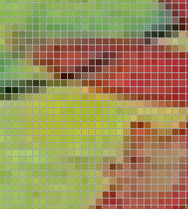
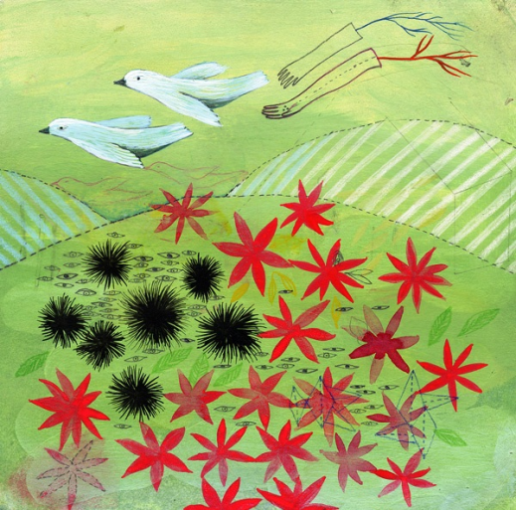
Digital Image
In digital imaging, a pixel (picture element) is the smallest piece of information in an image.
The word pixel is based on a contraction of pix (for "pictures") and el (for "element")
Each pixel is a sample of an original image, where more samples typically provide a more accurate representation of the original.
The intensity of each pixel is variable; in color systems, each pixel has typically three or four components such as red, green, and blue, or cyan, magenta, yellow, and black.
http://en.wikipedia.org/wiki/Pixel
Google.com image search

Slide 18

What is a digital image?
We usually operate on digital (discrete) images:
Sample the 2D space on a regular grid
Quantize each sample (round to nearest integer)
The image can now be represented as a matrix of integer values

Slide 19
Other Applications

Slide 20
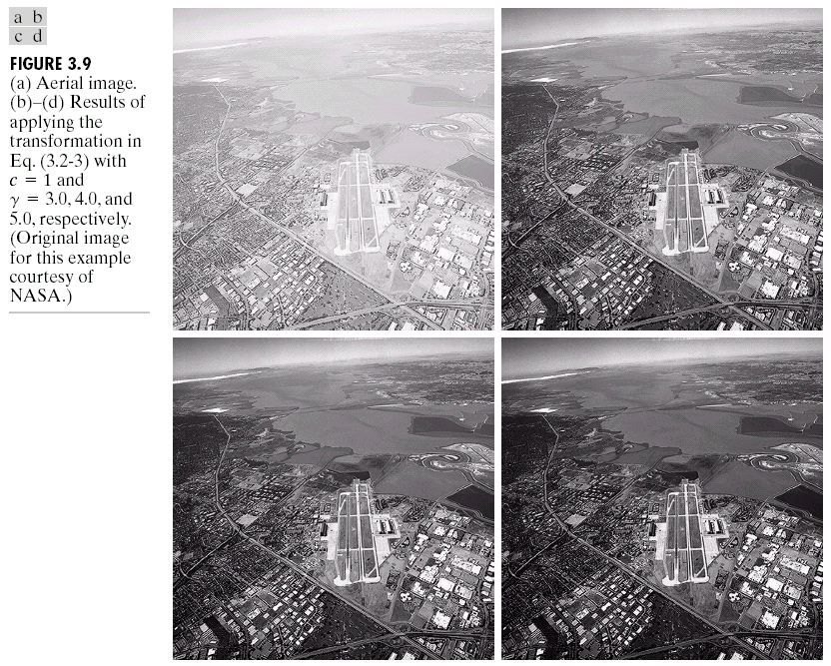
Image Enhancement

Slide 21
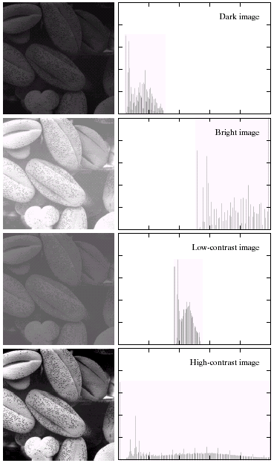
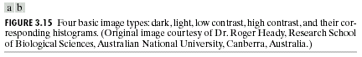
Image Histograms

Slide 22
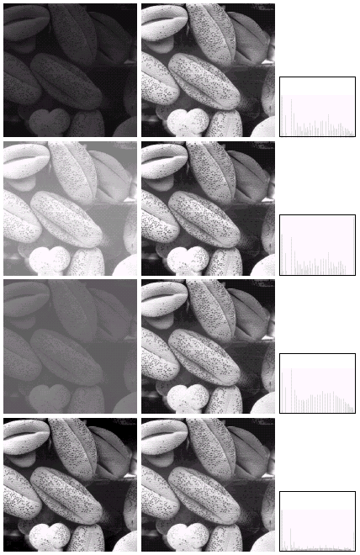
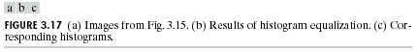
Histogram Equalization

Slide 23
How can we read images?

Slide 24
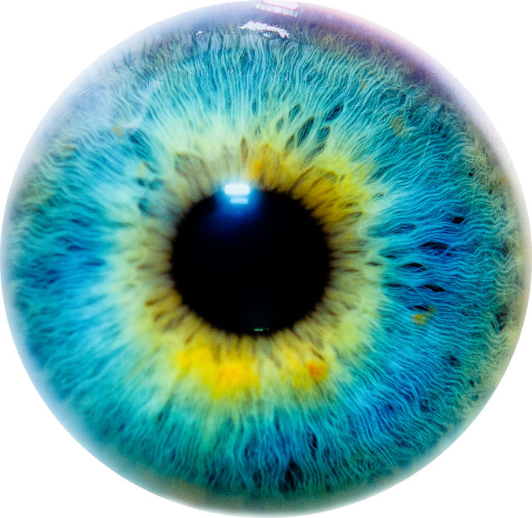
Image file Formats
Image file formats are standardized means of organizing and storing digital images.
Types of files
JPEG
PNG
BMP
GIF
PPM
PGM
Etc

Slide 25
How can we read these formats
So many different formats, which one is the best one?
Which one is the easiest to interpret?
The answer to these questions is not easy.
Best way to read these types of files is through libraries such as Cimg, libjpeg, OpenCV.

Slide 26

Simplest version
portable pixmap format (PPM), the portable graymap format (PGM)
These formats don’t use any sort of compression so they are big files but easy to read the data.
P2
# Shows the word "FEEP" (example from Netpbm man page on PGM)
24 7
15
0 0 0 0 0 0 0 0 0 0 0 0 0 0 0 0 0 0 0 0 0 0 0 0
0 3 3 3 3 0 0 7 7 7 7 0 0 11 11 11 11 0 0 15 15 15 15 0
0 3 0 0 0 0 0 7 0 0 0 0 0 11 0 0 0 0 0 15 0 0 15 0
0 3 3 3 0 0 0 7 7 7 0 0 0 11 11 11 0 0 0 15 15 15 15 0
0 3 0 0 0 0 0 7 0 0 0 0 0 11 0 0 0 0 0 15 0 0 0 0
0 3 0 0 0 0 0 7 7 7 7 0 0 11 11 11 11 0 0 15 0 0 0 0
0 0 0 0 0 0 0 0 0 0 0 0 0 0 0 0 0 0 0 0 0 0 0 0

Slide 27
Simplest version
In this PGM example
P2 means PGM
The next two numbers give the width and the height.
The next number represents the maximum value (numbers of grey between black and white)
Black is 0 and max value is white.
Then follows the matrix with the pixel values.
The PGM and PPM formats (both ASCII and binary versions)
P2
# Shows the word "FEEP" (example from Netpbm man page on PGM)
24 7
15
0 0 0 0 0 0 0 0 0 0 0 0 0 0 0 0 0 0 0 0 0 0 0 0
0 3 3 3 3 0 0 7 7 7 7 0 0 11 11 11 11 0 0 15 15 15 15 0
0 3 0 0 0 0 0 7 0 0 0 0 0 11 0 0 0 0 0 15 0 0 15 0
0 3 3 3 0 0 0 7 7 7 0 0 0 11 11 11 0 0 0 15 15 15 15 0
0 3 0 0 0 0 0 7 0 0 0 0 0 11 0 0 0 0 0 15 0 0 0 0
0 3 0 0 0 0 0 7 7 7 7 0 0 11 11 11 11 0 0 15 0 0 0 0
0 0 0 0 0 0 0 0 0 0 0 0 0 0 0 0 0 0 0 0 0 0 0 0

Slide 28
Code Examples

Slide 29
Simple algorithm
Brightness
Increase/Decrease the intensity of the pixels by a specific value
Lets look at the code

Slide 30
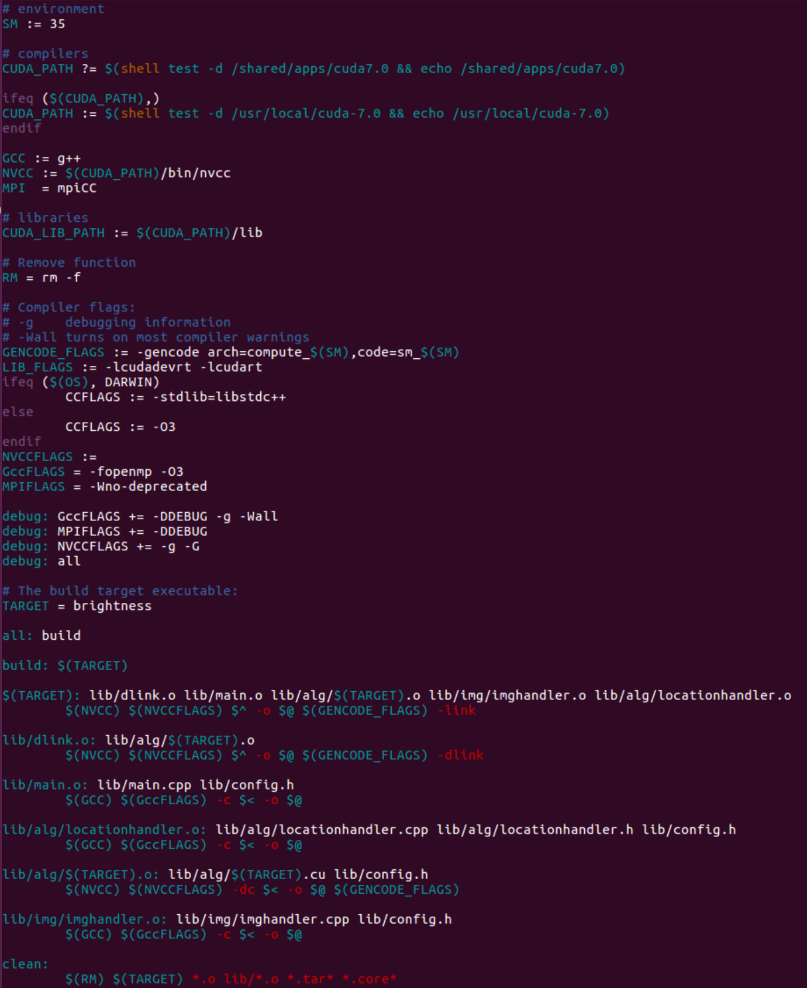
What is the Makefile?
Makefile’s are a simple way to organize code compilation.
A Makefile is a file containing a set of directives used with the make build automation tool from GNU.
Incredibly useful when your project becomes bigger and bigger.

Slide 31
int main(int argc, char* argv[]) {
// Files needed
char* imageFile = NULL;
// Load Intensity Image
image<unsigned char>* intensityInput = loadPGM(imageFile);
cpu.height = intensityInput->height();
cpu.width = intensityInput->width();
cpu.gridXSize = 1 + (( cpu.width - 1) / TILE_SIZE);
cpu.gridYSize = 1 + ((cpu.height - 1) / TILE_SIZE);
int XSize = cpu.gridXSize*TILE_SIZE;
int YSize = cpu.gridYSize*TILE_SIZE;
cpu.size = XSize*YSize;
cpu.intensity = new unsigned char[cpu.size];
for (unsigned int y = 0 ; y < YSize ; y++){
for (unsigned int x = 0 ; x < XSize ; x++){
unsigned int newLocation = imageLocation (x, y, cpu.gridXSize);
if (x < cpu.width && y < cpu.height) {
cpu.intensity[newLocation] = intensityInput->data[y*cpu.width + x];
} else{
// Necessary in case image size is not a multiple of TILE_SIZE
cpu.intensity[newLocation] = 0;
}
}
}
cpu.result = brightness(cpu.intensity,
cpu.height,
cpu.width);
// Output RGB images
char filename[64];
sprintf(filename, "result.ppm");
srand(1000);
Color color;
// Create output image
image<Color> output = image<Color>(cpu.width, cpu.height, true);
image<Color>* im = &output;
Color randomcolor = randomColor();
for (unsigned int y = 0 ; y < cpu.height ; y++){
for (unsigned int x = 0 ; x < cpu.width ; x++){
unsigned int newLocation = imageLocation (x, y, cpu.gridXSize);
color.r = cpu.result[newLocation];
color.g = cpu.result[newLocation];
color.b = cpu.result[newLocation];
im->access[y][x] = color;
}
}
savePPM(im, filename);
// Free resources and end the program
free(cpu.intensity);
return 0;
}

Slide 32
unsigned char *brightness(unsigned char *intensity,
unsigned int height,
unsigned int width){
int gridXSize = 1 + (( width - 1) / TILE_SIZE);
int gridYSize = 1 + ((height - 1) / TILE_SIZE);
int XSize = gridXSize*TILE_SIZE;
int YSize = gridYSize*TILE_SIZE;
// Both are the same size (CPU/GPU).
gpu.size = XSize*YSize;
// Allocate arrays in GPU memory
checkCuda(cudaMalloc((void**)&gpu.intensity , gpu.size*sizeof(char)));
checkCuda(cudaMalloc((void**)&gpu.result , gpu.size*sizeof(char)));
// Allocate result array in CPU memory
gpu.resultOnCPU = new unsigned char[gpu.size];
checkCuda(cudaMemcpy(gpu.intensity,
intensity,
gpu.size*sizeof(char),
cudaMemcpyHostToDevice));
checkCuda(cudaDeviceSynchronize());
dim3 dimGrid(gridXSize, gridYSize);
dim3 dimBlock(BLOCK_TILE_SIZE, BLOCK_TILE_SIZE);
// Launch kernel to begin image segmenation
brightnessAlgorithm<<<dimGrid, dimBlock>>>(gpu.intensity,
gpu.result,
inc);
checkCuda(cudaDeviceSynchronize());
// Retrieve results from the GPU
checkCuda(cudaMemcpy(gpu.resultOnCPU,
gpu.result,
gpu.size*sizeof(char),
cudaMemcpyDeviceToHost));
// Free resources and end the program
checkCuda(cudaFree(gpu.intensity));
checkCuda(cudaFree(gpu.result));
return(gpu.resultOnCPU);
}

Slide 33
__global__ void brightnessAlgorithm(unsigned char *intensity,
unsigned char *result,
unsigned int inc){
int tx = threadIdx.x;
int ty = threadIdx.y;
int bx = blockIdx.x;
int by = blockIdx.y;
// Read Input Data
int x = bx*TILE_SIZE+tx;
int y = by*TILE_SIZE+ty;
int location = y*(gridDim.x*TILE_SIZE)+x;
unsigned char value = intensity[location];
// Algorithm
if (value + inc > 255) result[location] = 255;
else result[location] = value + inc;
}

Slide 34
How can we improve brightness?
Shared memory?
Constant Memory?
Texture memory?
More processing per thread
Adding more work to each thread
Bring in more data on each read
Notes:
Not really right

Slide 35
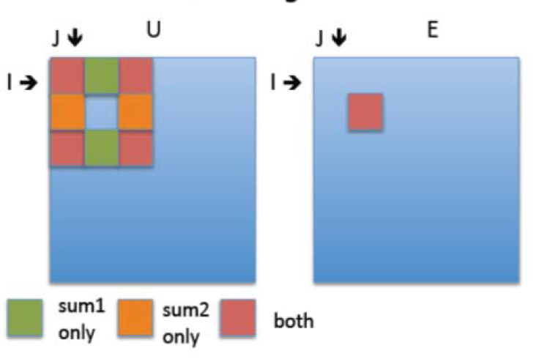
A more complex example
Sobel algorithm
Sobel edge detection
Find the boundaries of the image where there is significant difference as compared to neighboring “pixels” and replace values to find edges.

Slide 36
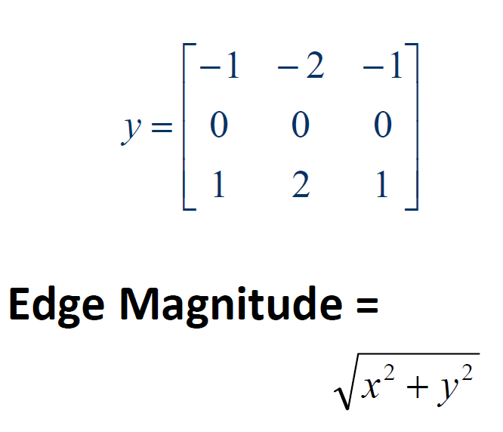
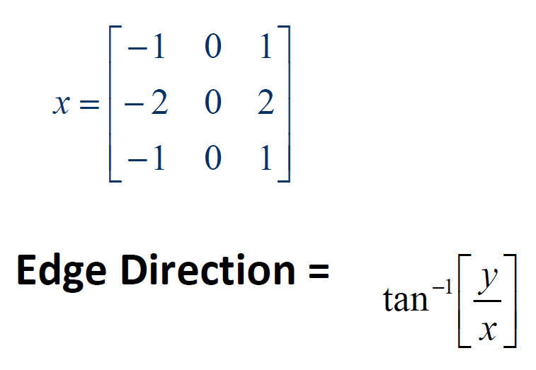
Sobel Algorithm
Looks for edges in both horizontal and vertical directions, then combine the information into a single metric.
The masks are:

Slide 37
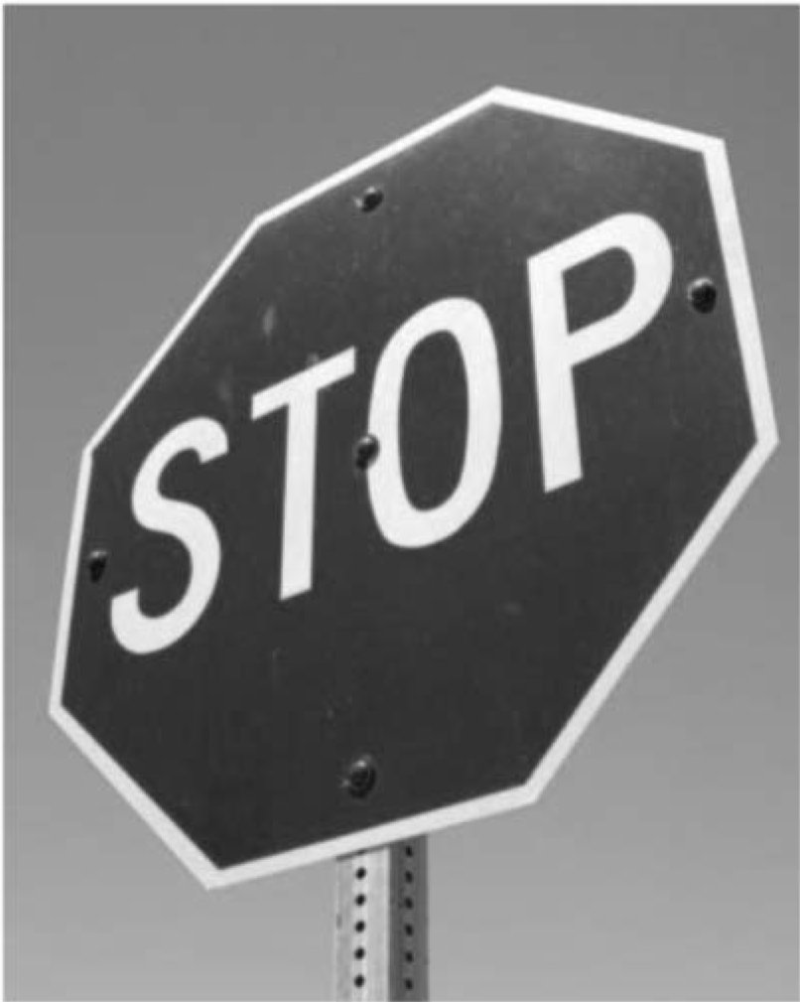

Sobel Algorithm
Output
Input

Slide 38
int main(int argc, char* argv[]) {
// Files needed
char* imageFile = NULL;
// Load Intensity Image
image<unsigned char>* intensityInput = loadPGM(imageFile);
cpu.height = intensityInput->height();
cpu.width = intensityInput->width();
cpu.gridXSize = 1 + (( cpu.width - 1) / TILE_SIZE);
cpu.gridYSize = 1 + ((cpu.height - 1) / TILE_SIZE);
int XSize = cpu.gridXSize*TILE_SIZE;
int YSize = cpu.gridYSize*TILE_SIZE;
cpu.size = XSize*YSize;
cpu.intensity = new unsigned char[cpu.size];
for (unsigned int y = 0 ; y < YSize ; y++){
for (unsigned int x = 0 ; x < XSize ; x++){
unsigned int newLocation = imageLocation (x, y, cpu.gridXSize);
if (x < cpu.width && y < cpu.height) {
cpu.intensity[newLocation] = intensityInput->data[y*cpu.width + x];
} else{
// Necessary in case image size is not a multiple of TILE_SIZE
cpu.intensity[newLocation] = 0;
}
}
}
cpu.result = sobel(cpu.intensity,
cpu.height,
cpu.width);
// Output RGB images
char filename[64];
sprintf(filename, "result.ppm");
srand(1000);
Color color;
// Create output image
image<Color> output = image<Color>(cpu.width, cpu.height, true);
image<Color>* im = &output;
Color randomcolor = randomColor();
for (unsigned int y = 0 ; y < cpu.height ; y++){
for (unsigned int x = 0 ; x < cpu.width ; x++){
unsigned int newLocation = imageLocation (x, y, cpu.gridXSize);
color.r = cpu.result[newLocation];
color.g = cpu.result[newLocation];
color.b = cpu.result[newLocation];
im->access[y][x] = color;
}
}
savePPM(im, filename);
// Free resources and end the program
free(cpu.intensity);
return 0;
}

Slide 39
unsigned char *sobel(unsigned char *intensity,
unsigned int height,
unsigned int width){
int gridXSize = 1 + (( width - 1) / TILE_SIZE);
int gridYSize = 1 + ((height - 1) / TILE_SIZE);
int XSize = gridXSize*TILE_SIZE;
int YSize = gridYSize*TILE_SIZE;
// Both are the same size (CPU/GPU).
gpu.size = XSize*YSize;
// Allocate arrays in GPU memory
checkCuda(cudaMalloc((void**)&gpu.intensity , gpu.size*sizeof(char)));
checkCuda(cudaMalloc((void**)&gpu.result , gpu.size*sizeof(char)));
// Allocate result array in CPU memory
gpu.resultOnCPU = new unsigned char[gpu.size];
checkCuda(cudaMemcpy(gpu.intensity,
intensity,
gpu.size*sizeof(char),
cudaMemcpyHostToDevice));
checkCuda(cudaDeviceSynchronize());
dim3 dimGrid(gridXSize, gridYSize);
dim3 dimBlock(BLOCK_TILE_SIZE, BLOCK_TILE_SIZE);
// Launch kernel to begin image segmenation
sobelAlgorithm<<<dimGrid, dimBlock>>>(gpu.intensity,
gpu.result,threshold);
checkCuda(cudaDeviceSynchronize());
// Retrieve results from the GPU
checkCuda(cudaMemcpy(gpu.resultOnCPU,
gpu.result,
gpu.size*sizeof(char),
cudaMemcpyDeviceToHost));
// Free resources and end the program
checkCuda(cudaFree(gpu.intensity));
checkCuda(cudaFree(gpu.result));
return(gpu.resultOnCPU);
}

Slide 40
__global__ void sobelAlgorithm(unsigned char *intensity,
unsigned char *result,
unsigned int threshold){
int tx = threadIdx.x;
int ty = threadIdx.y;
int bx = blockIdx.x;
int by = blockIdx.y;
int x = bx*TILE_SIZE+tx;
int y = by*TILE_SIZE+ty;
int xsize = TILE_SIZE*gridDim.x;
int ysize = TILE_SIZE*gridDim.y;
if (y > 1 && y < ysize-1 && x > 1 && x < xsize-1){
int location = y*xsize+x;
int sum1 = input[ xsize * (y-1) + x+1 ] - input[ xsize * (y-1) + x-1 ] +
2 * input[ xsize * (y) + x+1 ] - 2 * input[ xsize * (y) + x-1 ] +
input[ xsize * (y+1) + x+1 ] - input[ xsize * (y+1) + x-1 ];
int sum2 = input[ xsize * (y-1) + x-1 ] + 2 * input[ xsize * (y-1) + x ] +
input[ xsize * (y-1) + x+1 ] - input[ xsize * (y+1) + x-1 ] -
2 * input[ xsize * (y+1) + x ] - input[ xsize * (y+1) + x+1 ];
int magnitude = sum1*sum1+sum2*sum2;
if (magnitude > threshold) result[location] = 255;
else result[location] = 0;
}
}

Slide 41
Final Project
Open File

